Slide 1
Did you vagrant destroy?
Or, do you want to vagrant up again?

Slide 2
GET with a script - ProPublica
Vocabulary sidebar: vagrant commands
Just in case you’re wondering why we keep saying “destroy,” here’s a quick refresh on the vagrant commands in the order in which you learned them. You must run these commands in Terminal/the command prompt in the directory where your aspace.box file is. (See following slides, or Google how to navigate within Terminal/the command prompt).
Things you need only do when using a vagrant box for the first time (so if you downloaded the Windows 10 vagrant, you’ll need to do these):
vagrant --version = this just checks to make sure the program called Vagrant is installed
vagrant box add --name aspace = see the workshop slide for using this command, but this command is naming the box “aspace” so you can refer to it that way in later commands. You could have multiple boxes running at the same time, and thus they need names.
vagrant init aspace = This initializes the aspace box, which you just named “aspace,” above
Commands you’ll use more than once if you want to keep using the vagrant box:
vagrant up = equivalent to starting your computer up
vagrant destroy = equivalent to shutting your computer down. You can toggle between this and vagrant up in the course of daily work.
vagrant global-status = this will tell you whether the vagrant is running or not, in case you lose track.
vagrant box remove aspace = equivalent to uninstalling the vagrant (but it is still present as a file on your machine). You use this if you want to start over with a fresh box (or abandon ship)
Notes:
Lora mac; Valerie PC

Slide 3

GET with a script - ProPublica
Did you vagrant destroy?
Determining whether the vagrant is still running is super quick:
1. Mac users open Terminal; Windows users open the command prompt
2. Type vagrant global-status and hit enter.
Note: The command prompt is not Cgywin, we specifically mean the command prompt on this slide:
Notes:
Lora mac; Valerie PC

Slide 4
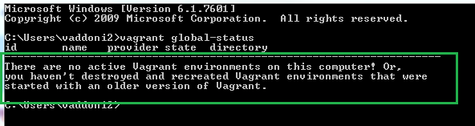
GET with a script - ProPublica
Did you vagrant destroy?
If you see this text or something similar, you’re good to go! The vagrant is not running.
If you do want it running again, keep clicking through slides.
Notes:
Lora mac; Valerie PC

Slide 5
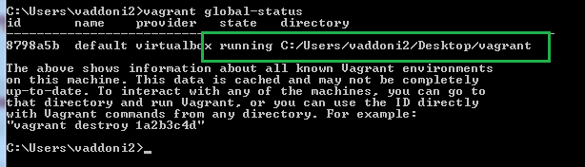
GET with a script - ProPublica
Did you vagrant destroy?
If you see this text or something similar, vagrant is still running!
If you want to shut it down, keep clicking through slides.
Notes:
Lora mac; Valerie PC

Slide 6
Do you want to vagrant up again?
Note: These instructions are for launching the vagrant after you have already followed the vagrant instructions in class. If this is your first time doing this, or the first time with a new aspace.box file, follow the class slides instead.
Mac
PC
Go to the vagrant folder you created in the workshop, likely on your desktop. It should still have aspace.box in it, plus a few new files.
Go to the vagrant folder you created in the workshop, likely on your desktop. It should still have aspace.box in it, plus a few new files.
Notes:
Lora mac; Valerie PC

Slide 7
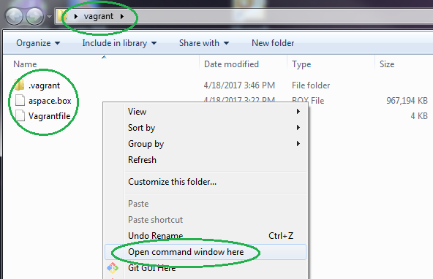
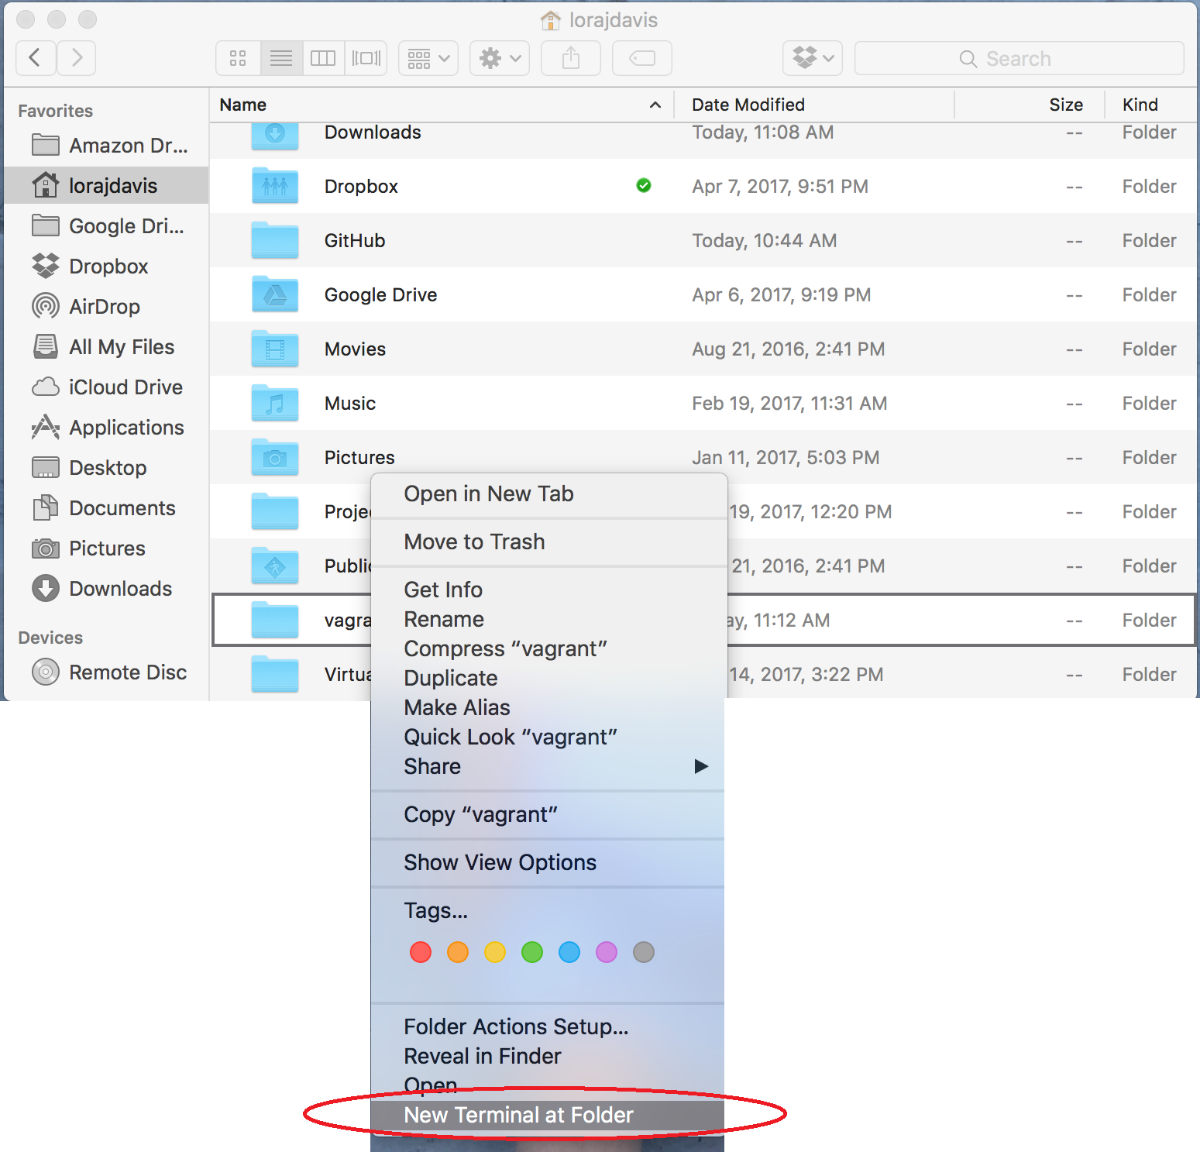
Mac
PC
Open terminal in that folder. The following screenshot won’t work for everyone depending on how old your Mac is:
Open the command prompt in that folder with shift+right-click:
Note: The command prompt is not Cgywin, we specifically mean the command prompt on this slide:
Notes:
Lora mac; Valerie PC

Slide 8
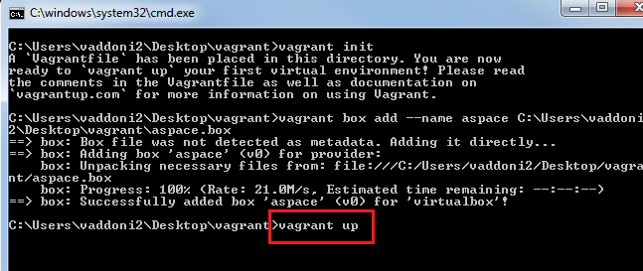
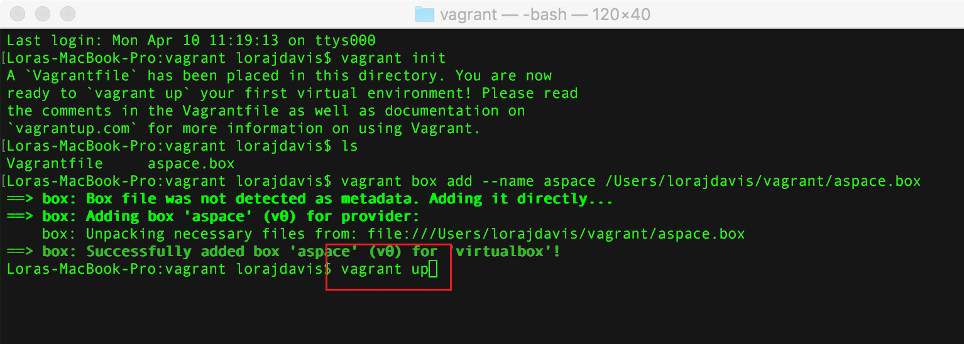
Do you want to vagrant up again?
Mac
PC
Type vagrant up and hit enter
Notes:
Lora Mac; Valerie PC

Slide 9
Check Vagrant backend
Open browser, navigate to:
http://localhost:8089
Notes:
Valerie

Slide 10

Check Vagrant staff interface
Try: http://localhost:8080
Now you have a personal ArchivesSpace! It’s yours and it’s re-useable! Look around.
Username: admin
Password: admin
Notes:
Valerie

Slide 11
Shutting down your Vagrant box
Do the following in Terminal/the command prompt:
Type vagrant destroy and confirm the command by typing y when prompted
“Destroying” is equivalent to hitting “shut down” on your computer; the computer is still sitting on your desk with your work saved, but it is powered off.
Type vagrant box remove aspace to remove the box completely
If “destroying” a box is like shutting down, “removing” a box is like taking a time machine back to the day you first cut the shrink wrap on your brand new computer. All work you have done in the virtual environment will be lost, but, once the box is re-added and upped again, you will be back to the exact version we shared with you here.
Notes:
Lora

